Slide 1

React Workshop
Day 3

Slide 2
React component:
Two types of react components:
One – class component
Two – functional component
Everything in react is component.
We reuse component
class App{}
function App(){}
App component in class and function structure.

Slide 3
State and props:
In react we define data as a state which holds data and changes its value in component.
state is used so that a component can keep track of information in between any renders that it does.
State can be updated in component but props shouldn’t be changed.
Props is used as a data which is transferred between components.
Props is used to communicate between two comonents.
State can be access by (this.state) while props can be accessed by (this.props)

Slide 4
jsx
JavaScript xml
Jsx is combination of JavaScript and html in react.
We can directly access JavaScript inside html element inside curly braces.
<p>my name is {name}</p>
name in curly braces is variable that is directly accessed in p element.

Slide 5
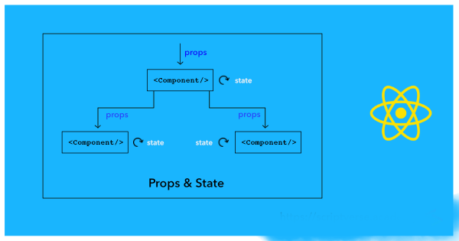

Slide 6
Lifecycle Methods
Constructor() – initial state and props
componentWillMount() – deprecated
Render()
componentDidMount()
componetWillReceiveProps()
shouldComponetUpdate()
componentWillUpdate()
render()
componentDidUpdate()
componentWillUnmount()

Slide 7
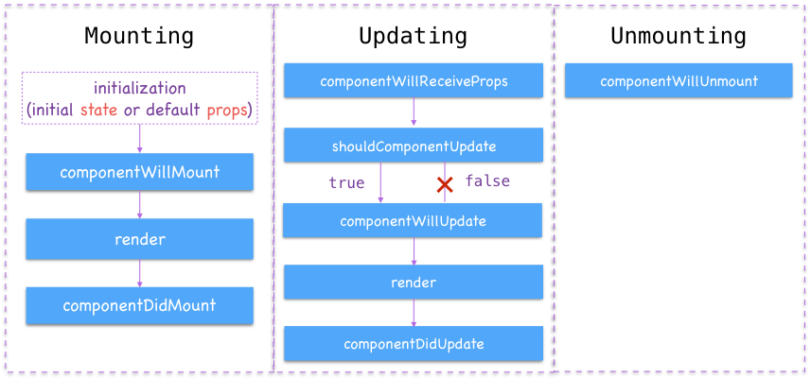

Slide 8
Updating the Rendered Element
React Only Updates What’s Necessary
Eg - Update current time in each second

Slide 9
Handling events
Event are actions
Event is fired when action is generated.
No need to call addEventListener to add listeners to a DOM element
Eg - onClick
Passing Arguments to Event Handlers

Slide 10
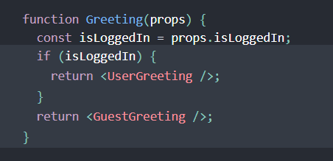
Conditional Rendering
Conditional rendering in React works the same way conditions work in JavaScript.

Slide 11
List and Keys
let’s review how you transform lists in JavaScript.
Rendering Multiple Components
Basic List Component
Keys

Slide 12
Building Reusable Components

Slide 13
Forms

Slide 14
Lifting State Up
Currency convener

Slide 15
Styling with react

Slide 16
Composition vs inheritance
we recommend using composition instead of inheritance to reuse code between components.

Slide 17
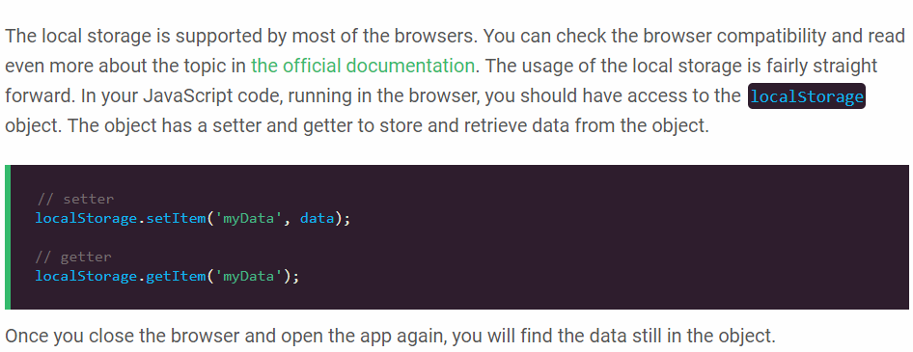
local storage

